Slide 1
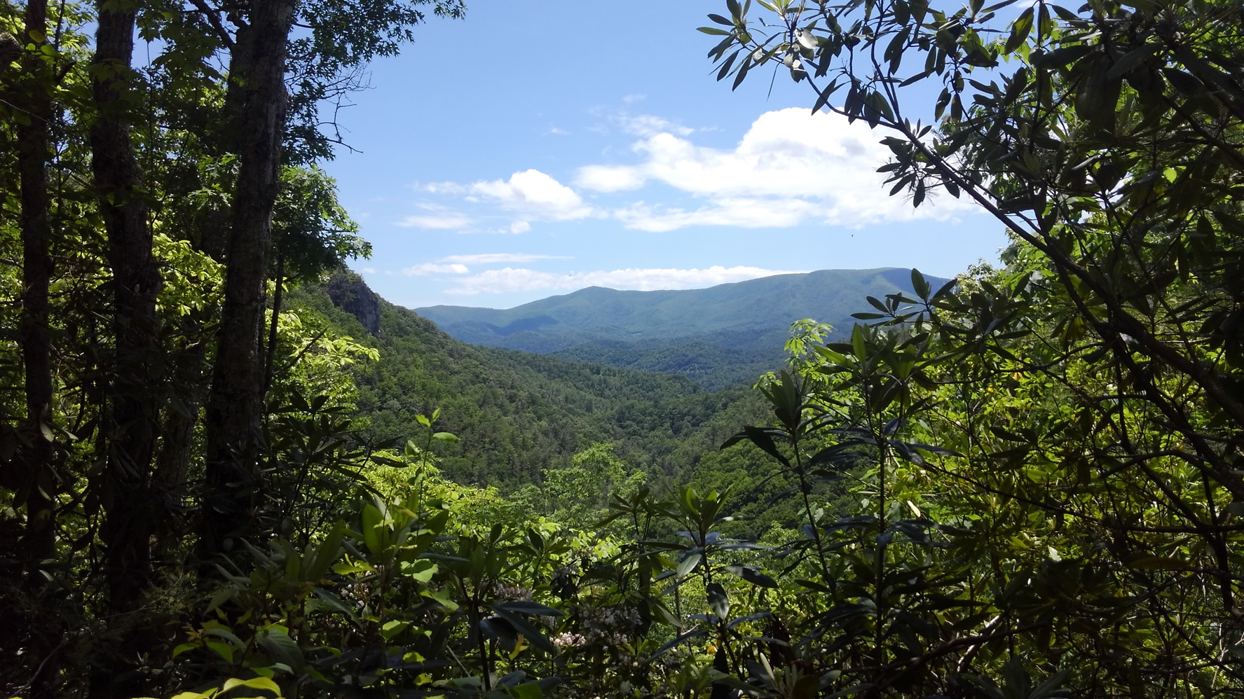
Investigating the proximate mechanisms of habitat constraints in two species of Plethodontid salamanders in the Southern Appalachian Mountains Trevor Chapman Dr. Joe Bidwell

Slide 2
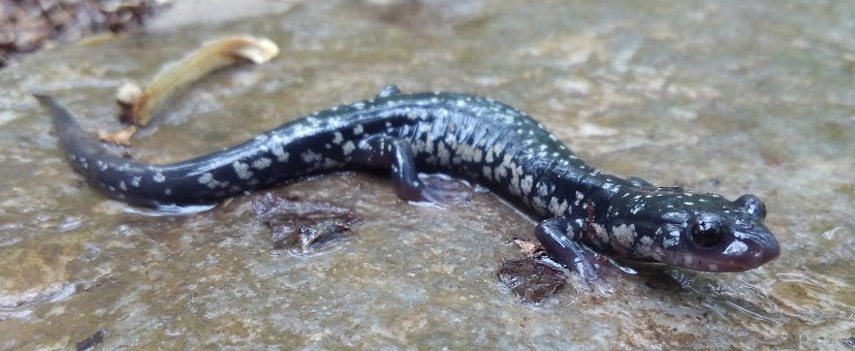
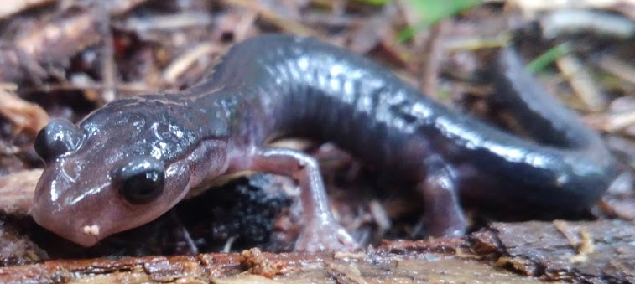
Background
Role of environmental variables and competition in determining species distributions
Optimal abiotic conditions = resource
Compete for time and space
Montane habitats
P. glutinosus
P. montanus

Slide 3
Objectives
Phase I
Determine occurrence across elevations
Characterize habitat microclimate
P. montanus and P. glutinosus
Phase II
Behavioral preference
Compare preference to occurrence
Effect of competition on preference

Slide 4
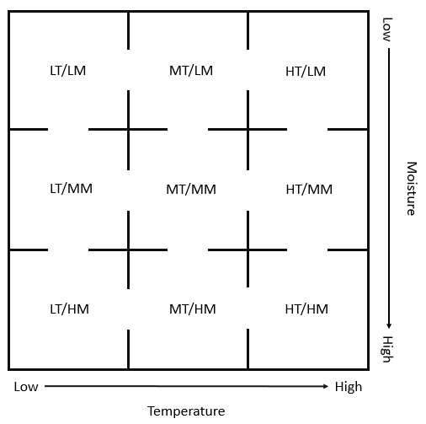

Slide 5
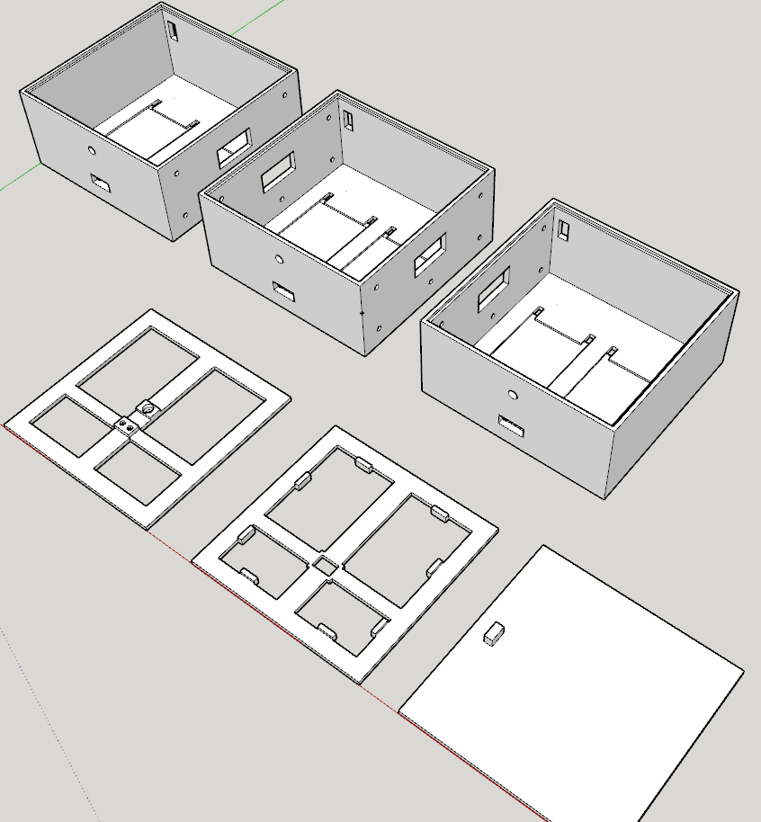
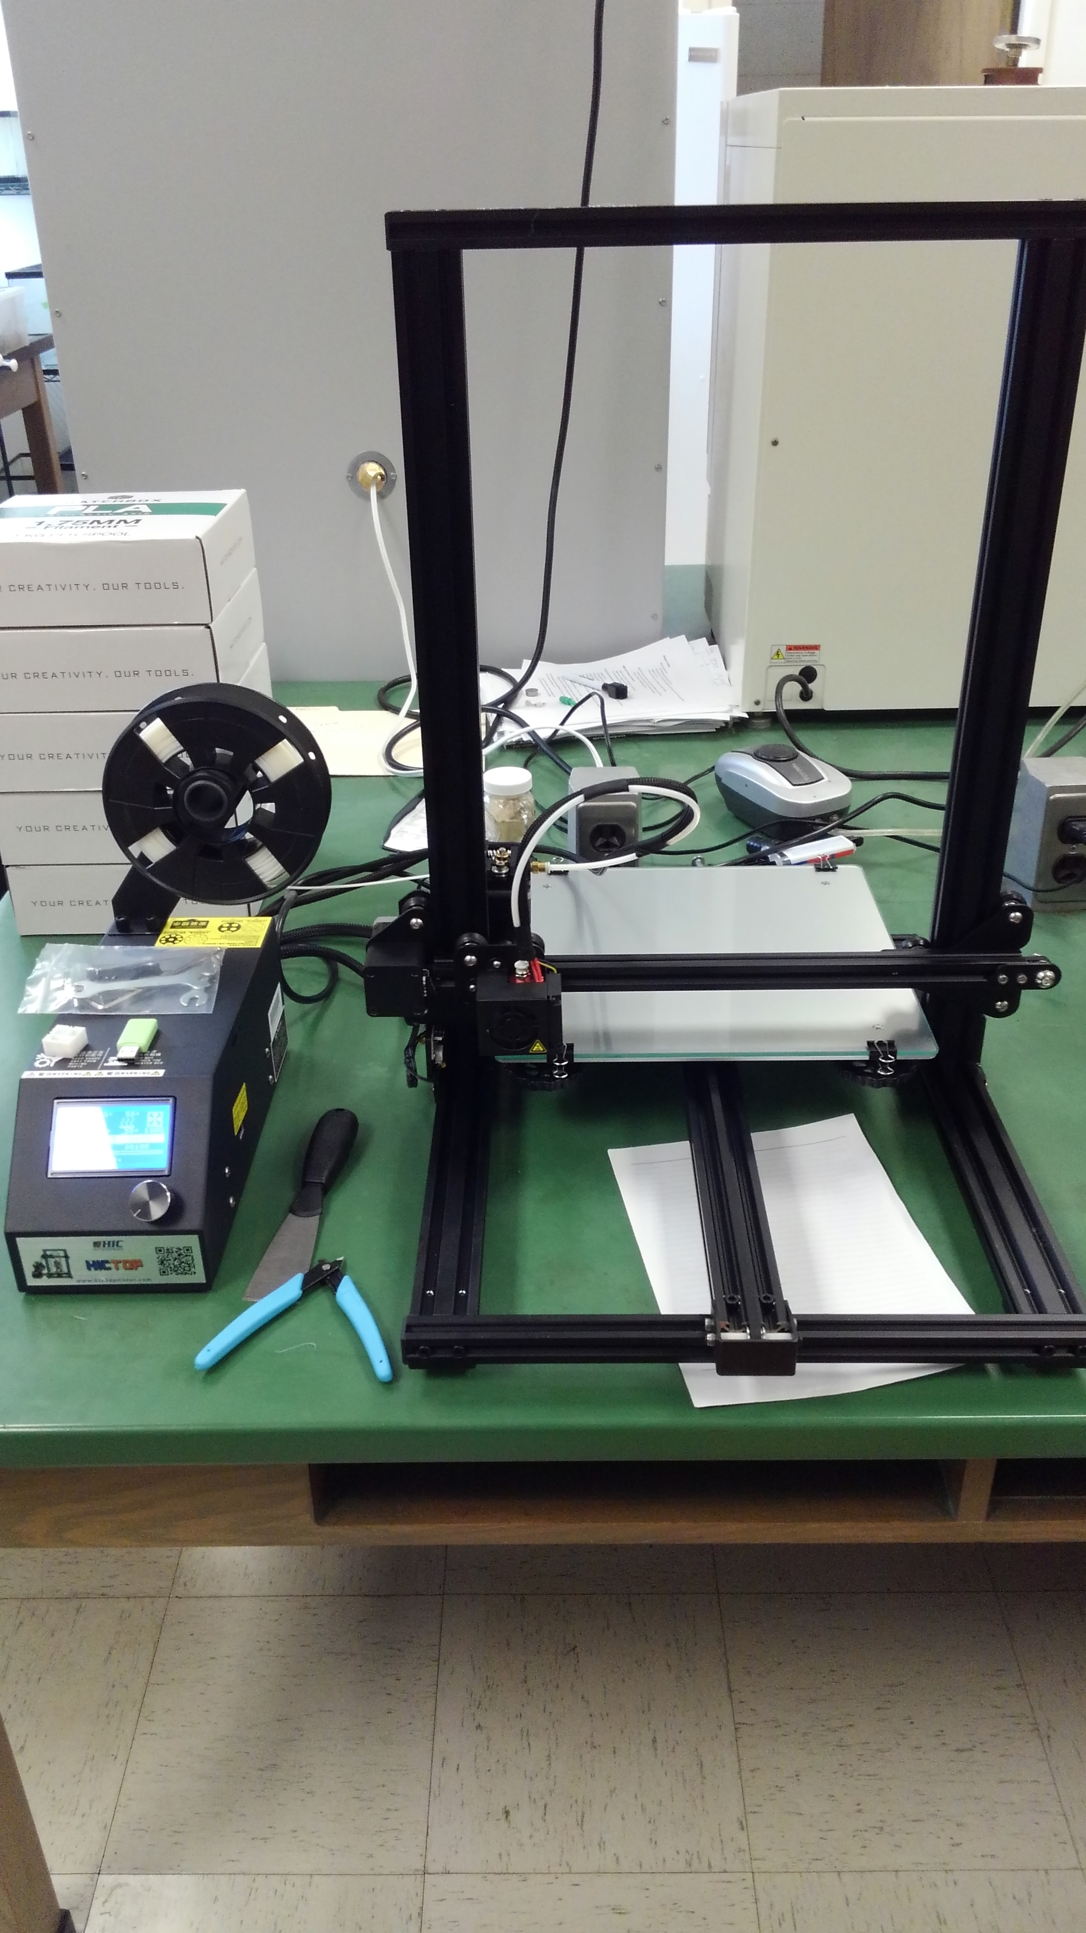

Design and Construction

Slide 6
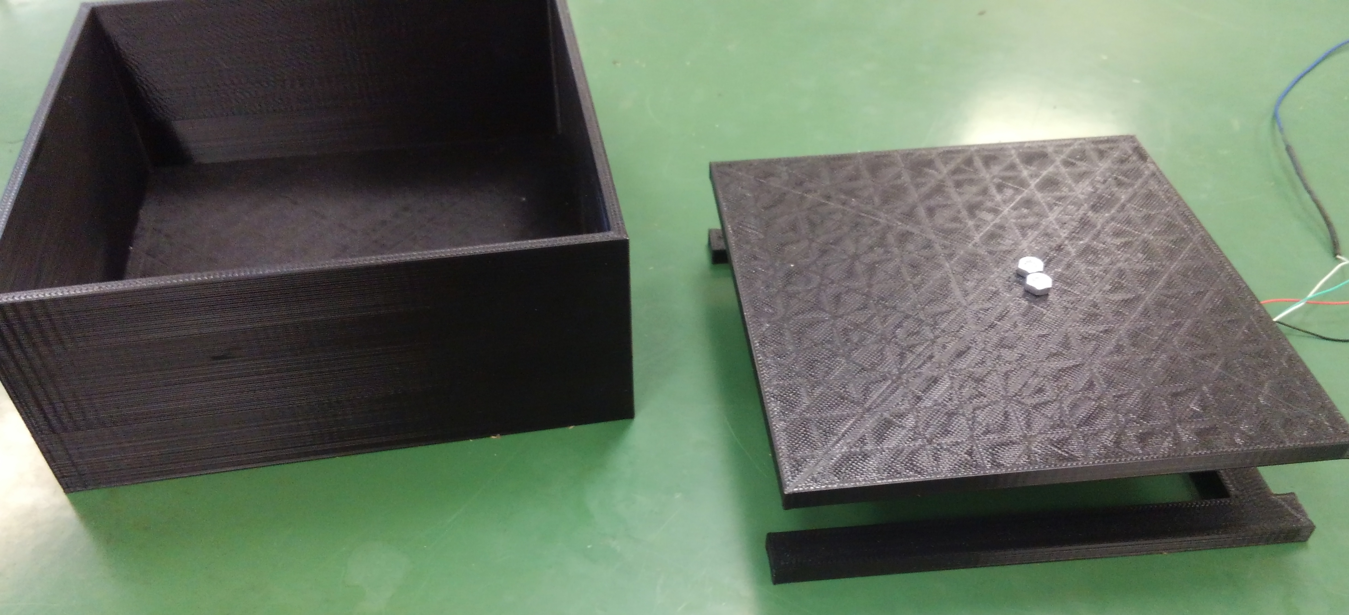
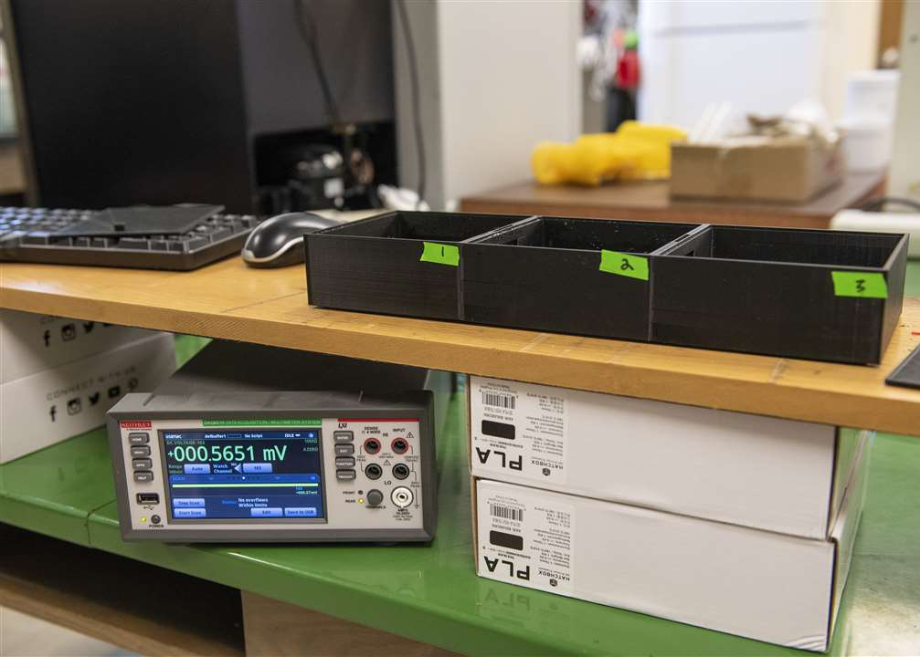
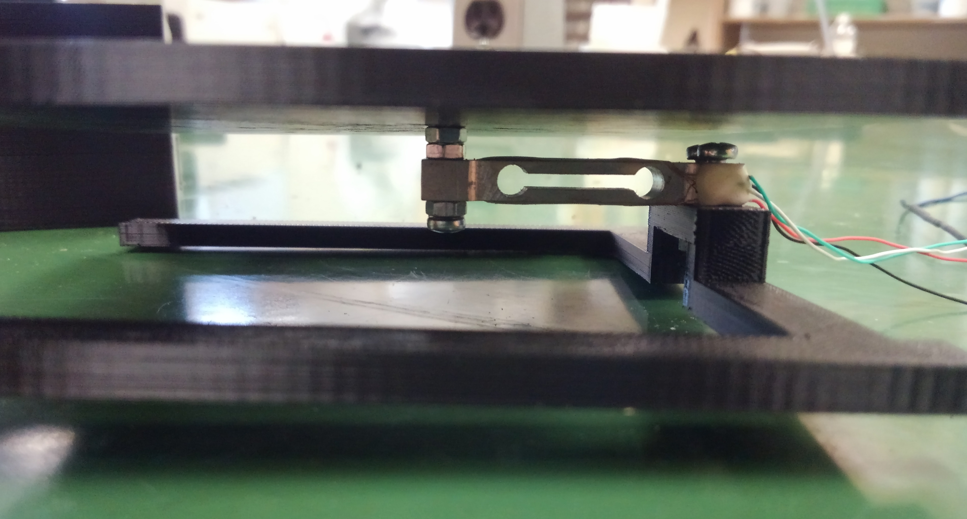
Automating data collection

Slide 7
Controlling Temperature and RH
POWER
POWER
Affects
Temperature
Affects
RH
16.9
89
17.1
91
SENSOR

Slide 8
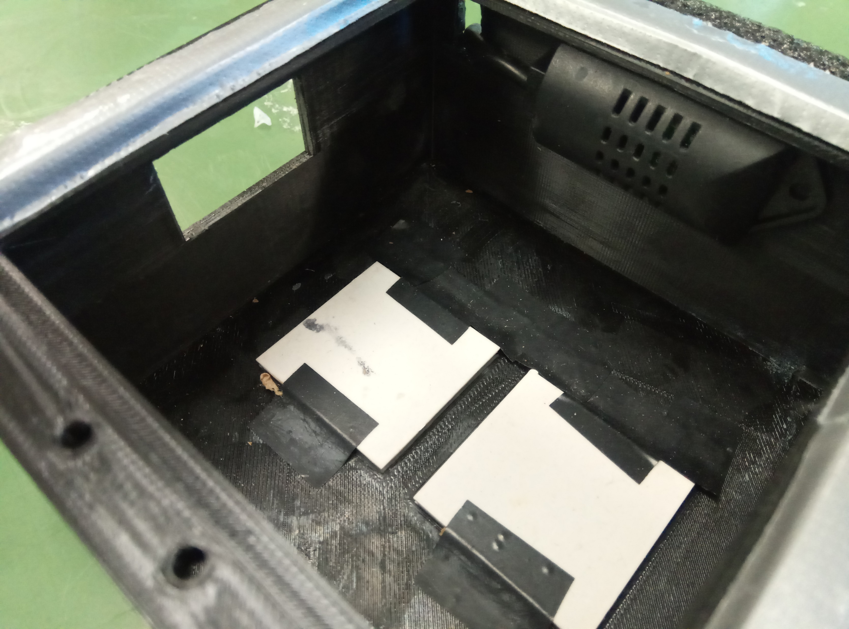
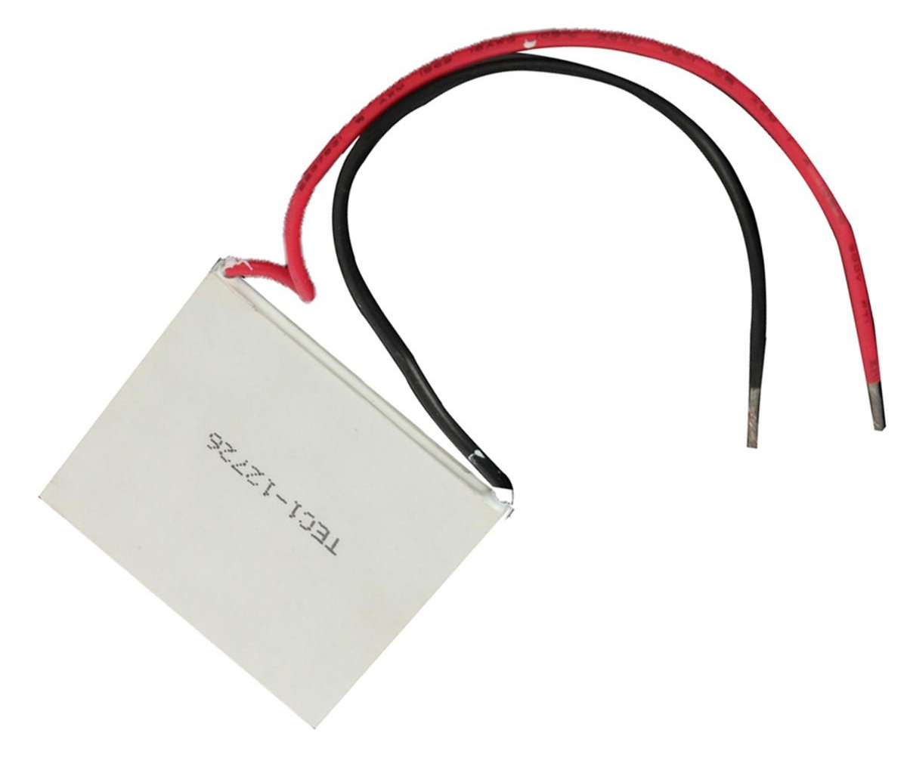
Peltier thermoelectric module
Ambient temp below desired
Relay open = no heat
Relay closed = heat

Slide 9
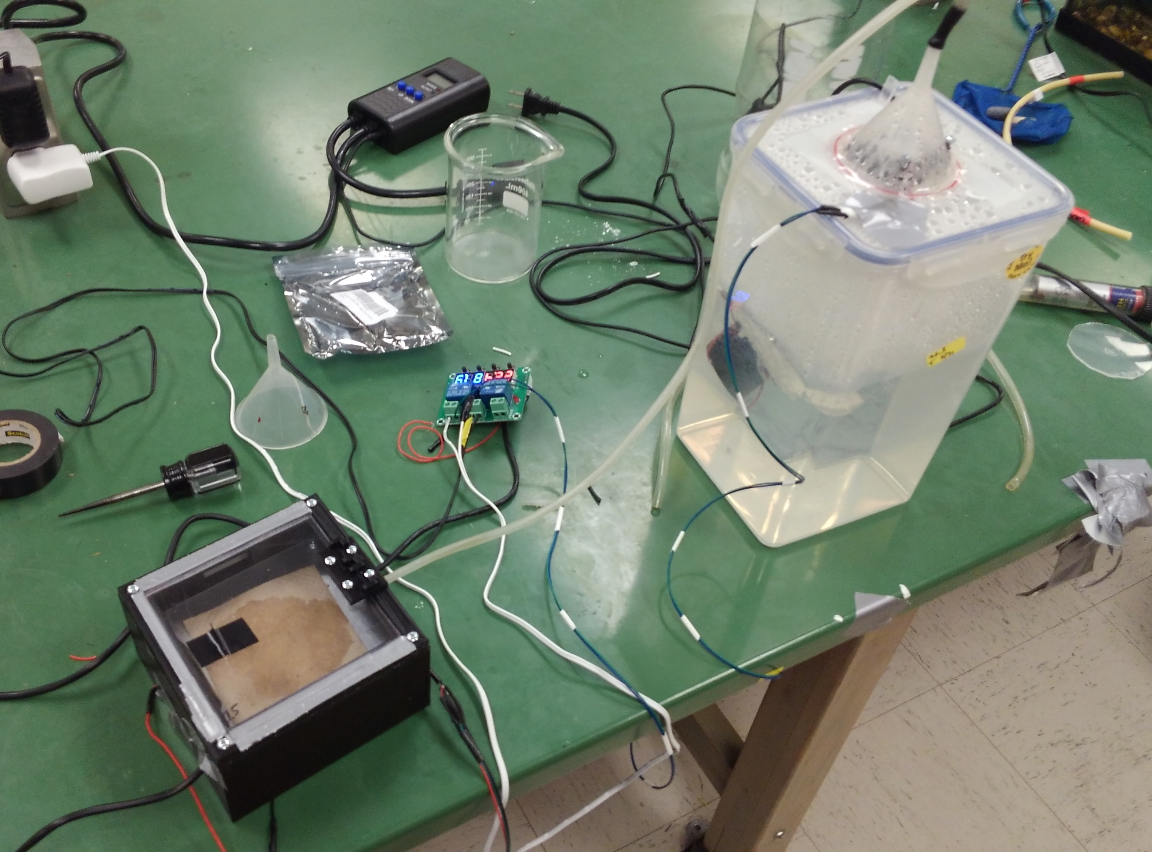
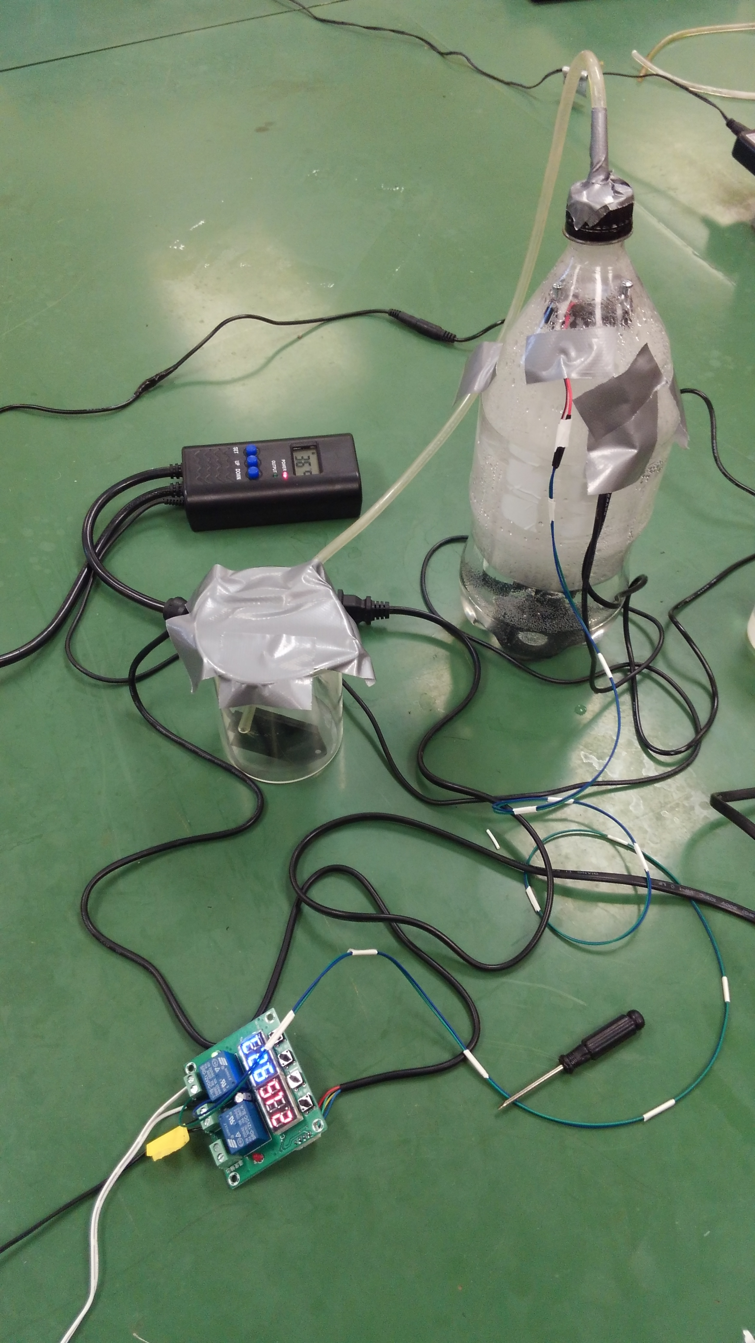
RH a little more complicated....

Slide 10

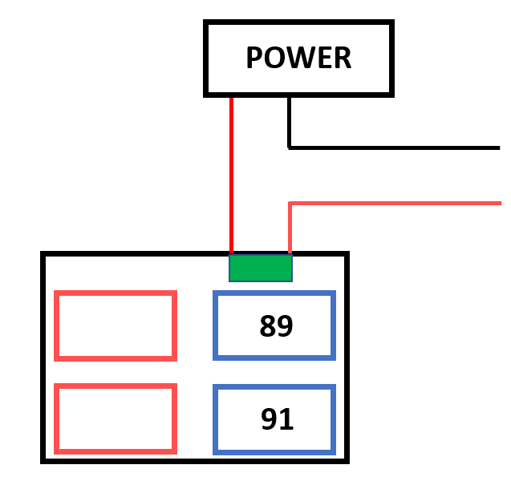
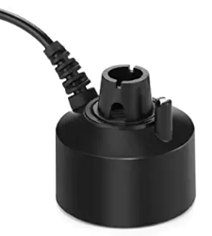

Slide 11
RH Above 91%
OFF

Slide 12
RH Below 89%
ON

Slide 13
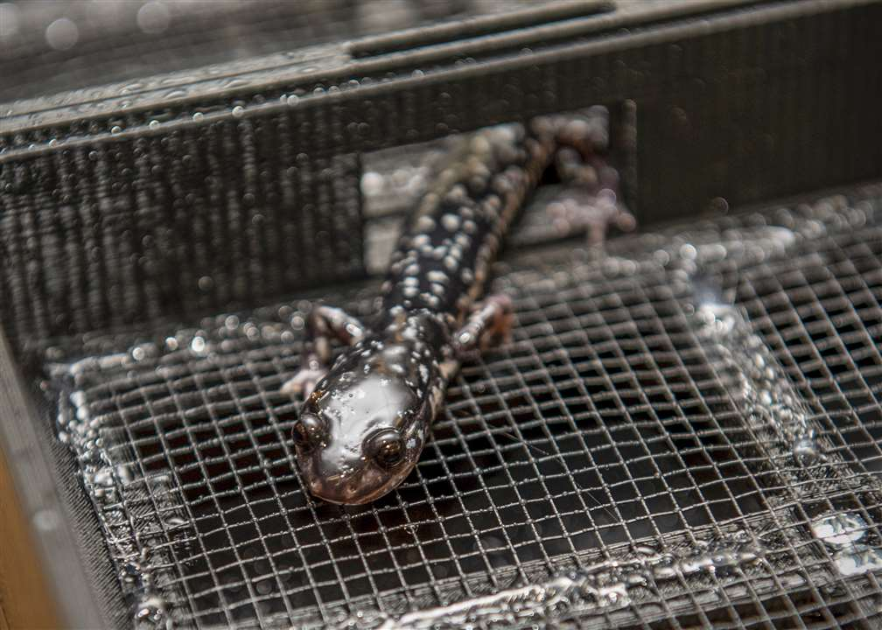
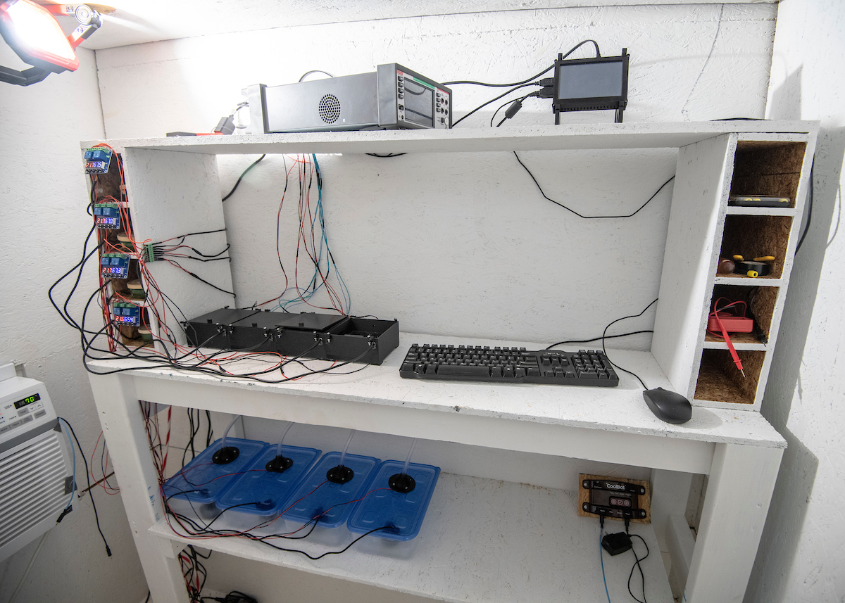
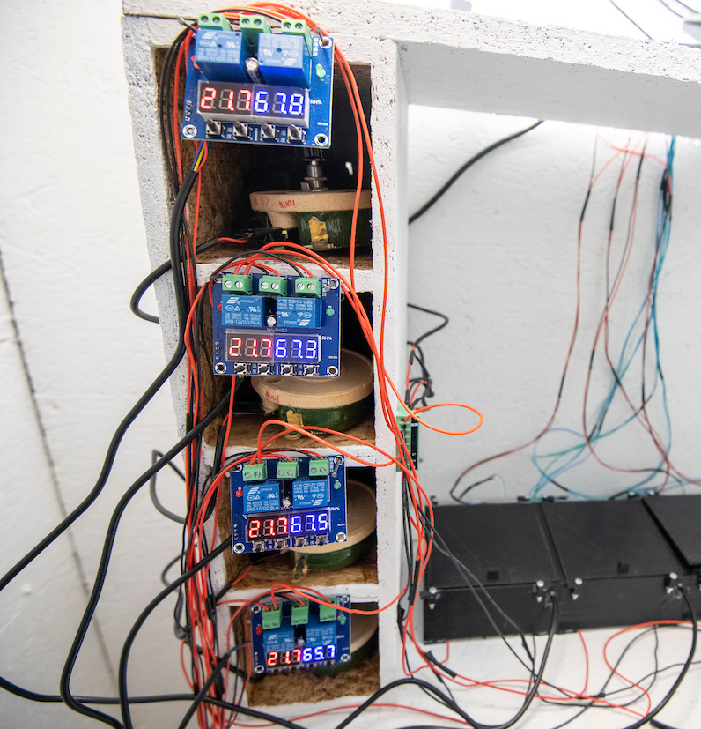
Current system
Charlie Warden, ETSU

Slide 14
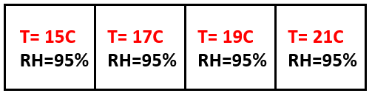
Experimental design
Setup:
Scan interval = 60 sec
Protocol:
Allow 5 scans for baseline voltages
Introduce salamander to a chamber (random # generator)
Data recorded for 24 h
First 30 min acclimation
Remove salamander, measure TL/SVL, release, sanitize arena

Slide 15
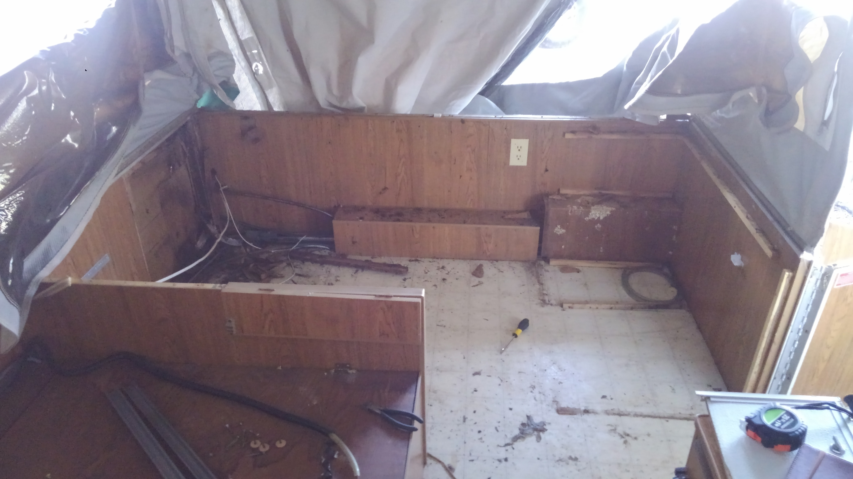
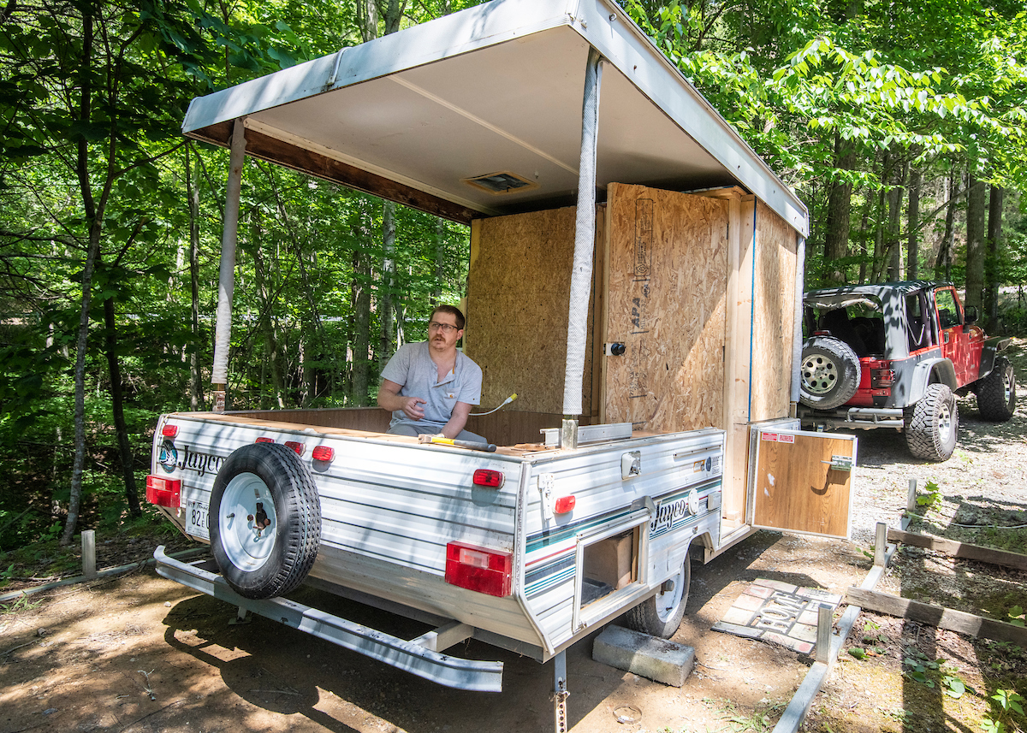
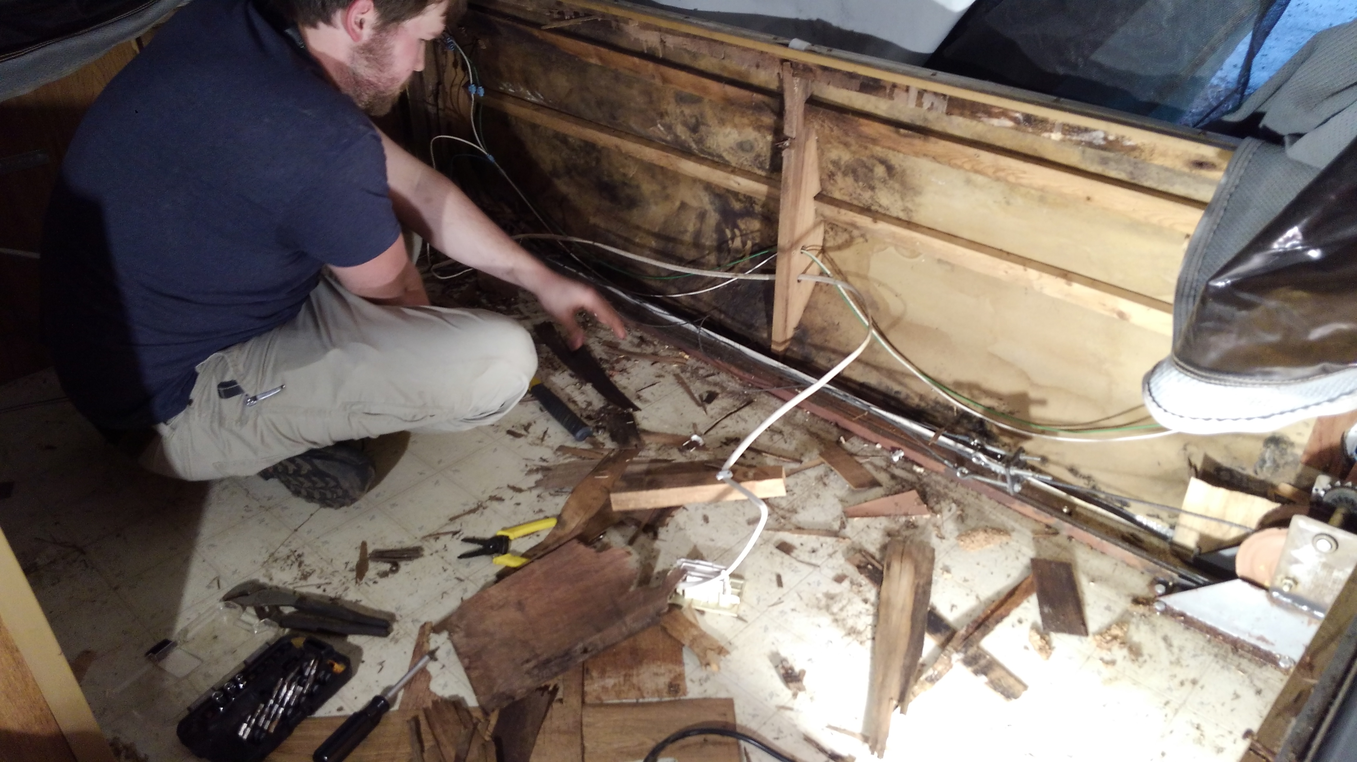
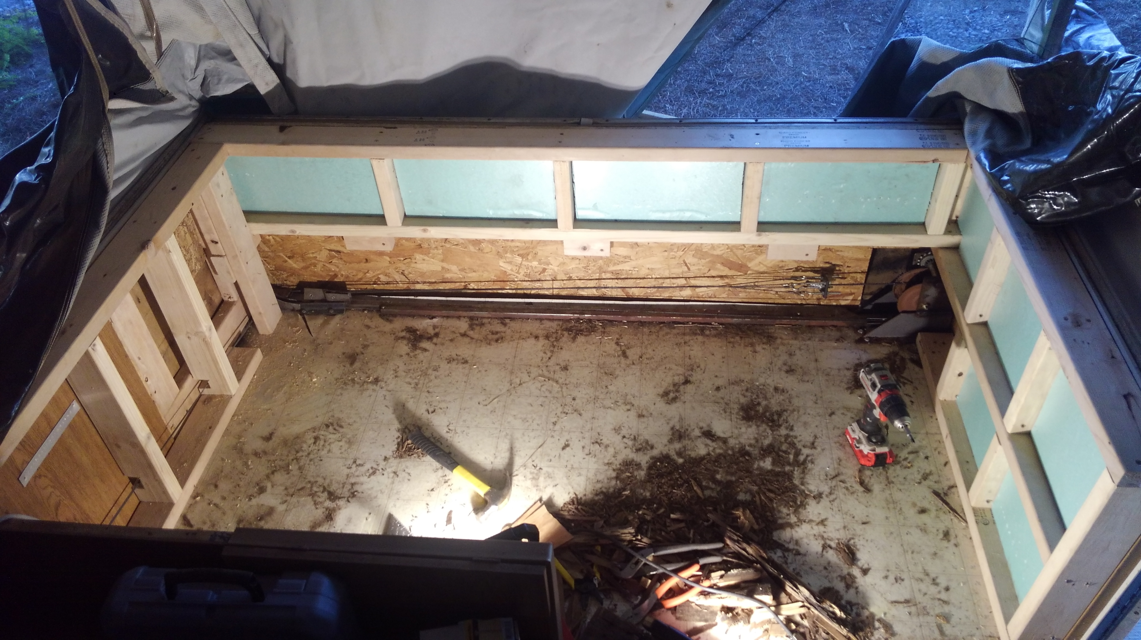
Plethodon Popup
Charlie Warden, ETSU

Slide 16
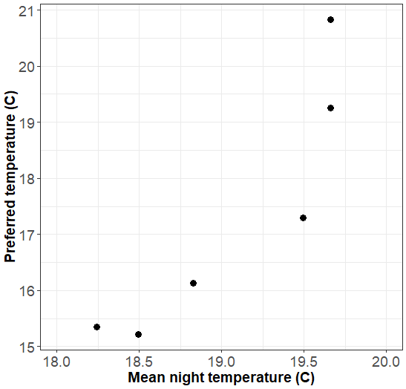
P. montanus preference
F=15.82, P=0.016
R² = 0.80

Slide 17
Future directions and implications
More data for P. glutinosus (monthly for both)
Thermal preference at varying RH
Limited to 1 by X arena design
Effect of competition on preference
Chemical cues
Habitat exploitation/restriction

Slide 18

Acknowledgements
Dr. Joe Bidwell, Tyler Wicks, Anna Grace Grizzard, John Roden, Brian Dempsey, Celeste Gallardo, Lindy and Ken Cutshall
Funding provided by ETSU RDC and Experiment.com
TWRA Permit #1549
TDEC Permit #2018-004

